Slide 1
Boolean Algebra
Lecture 1

Slide 2
Algebra
Ordinary algebra is about letters that represent numbers, and operations on those letters.
  e.g. 3(y + 2) = 3y + 6
  ab = ba

Slide 3
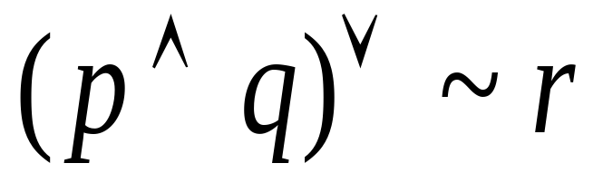
Boolean algebra
Boolean algebra is about letters that represent statements (that are either T or F), and operations on those letters.
  e.g.

Slide 4
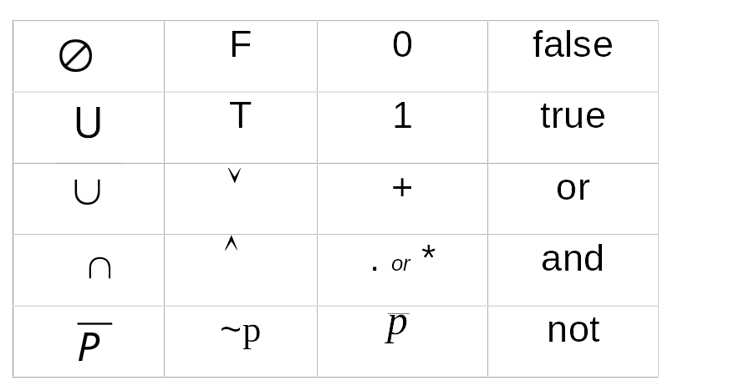
Sets Statement Boolean English
(next week) Algebra Algebra Equivalent

Slide 5
Boolean Algebra
When doing boolean algebra it is normal to use
+ for OR
* for AND
In fact usually the AND symbol is omitted.
This makes the expression look like ordinary algebra – but be careful because the operations are not the same.

Slide 6
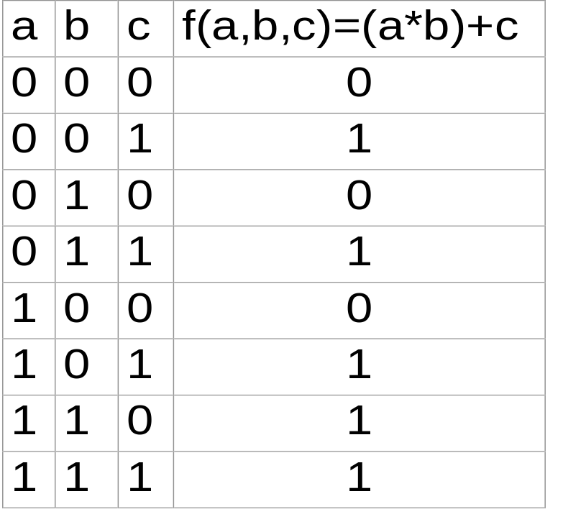
The values of a Boolean function can be read from each line of a truth table
f(a, b, c) = (a*b)+c
f(1, 0, 0) = 0
f(0, 1, 1) = 1
etc

Slide 7
Definition - Boolean Algebra
A Boolean Algebra consists of
a set of statements
2 binary operators
1 unary operator
2 identities
and satisfies 5 axioms (laws)

Slide 8
Boolean Axioms
Commutative
Associative
Distributive
Identity
Complementation
Note: Boolean algebra is about statements that are either T or F. Some of the rules for statements are the same as ordinary algebra (which is about numbers)

Slide 9
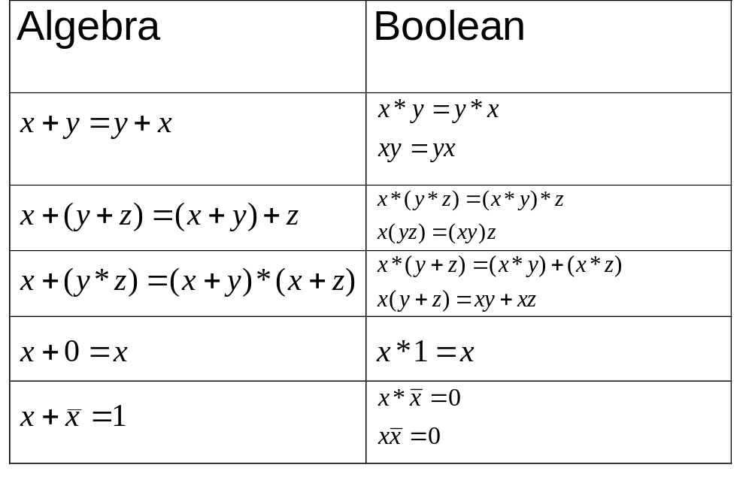
Boolean Axioms

Slide 10
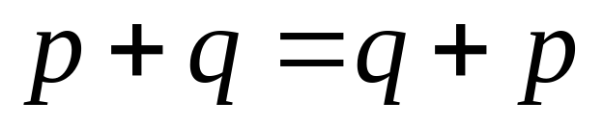
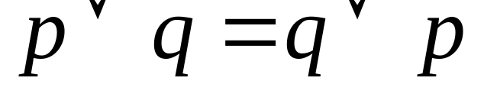
Commutative
Order doesn’t affect the result

Slide 11
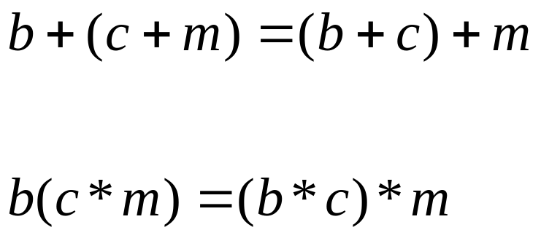
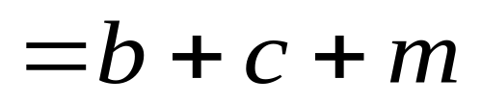
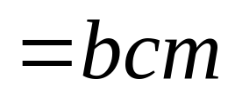
Associative
Expression with three variables and two identical operators

Slide 12
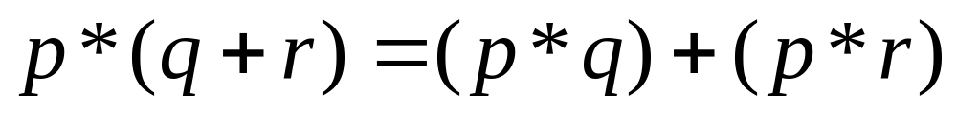
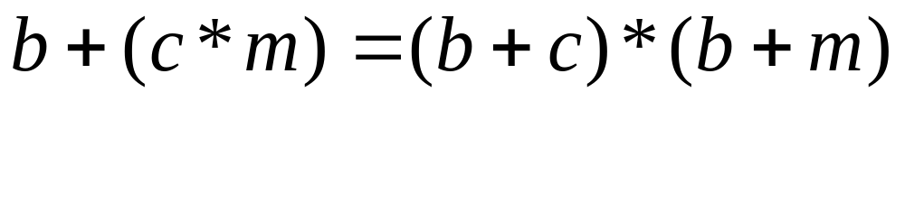
Distributive
Expression with three variables and two different operators

Slide 13


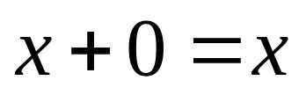
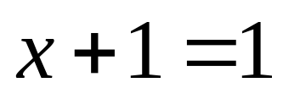


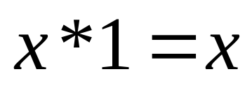
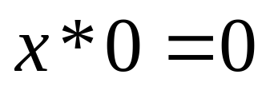
Identity Laws
(identity) but
(identity) but

Slide 14
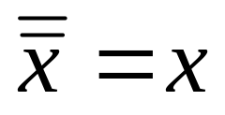



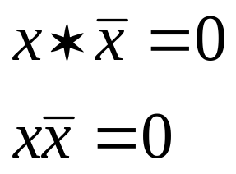
Complement or Inverse Law

Slide 15
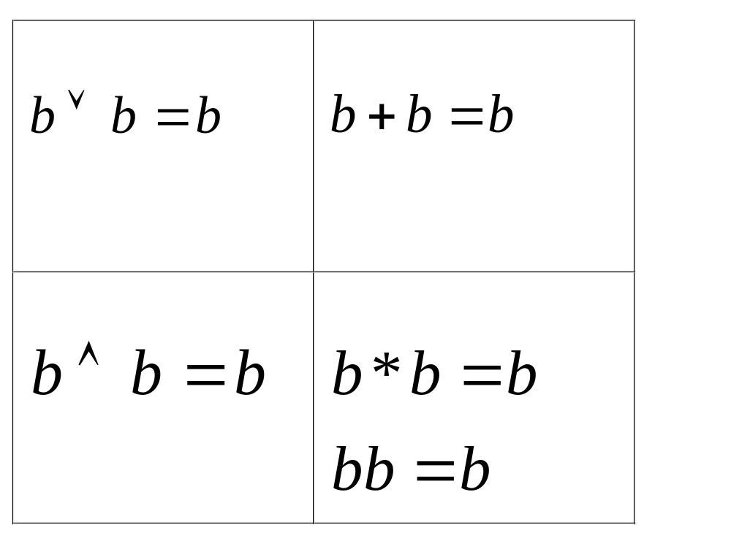
Idempotent Laws

Slide 16
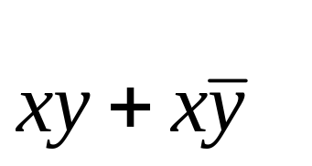

Examples 1
Simplify
= x * (y + ~y) = x * 1 = x
Simplify
= (a + b) * (c + ~c) = (a + b) * 1 = a + b

Slide 17
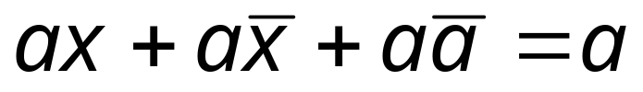
Example 2
Show that
and note the law used at each step
a * (x + ~x + ~a) = a [distributive]
a * ((x + ~x) + ~a) = a [associative]
a * (1 + ~a) = a [complement]
a * 1 = a [identity]
a = a [identity]

Slide 18
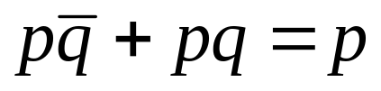

Example 3
Are the following true? Show working.
p * (~q + q) = p [distributive]
p * 1 = p [complement]
p = p [identity]
~pq = q [cancellation]
Not always true

Slide 19

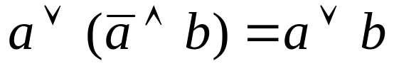
Example 4
Prove the following – and note the law used at each step
a)
pp + p~q + pq + q~q = p [distributive]
pp + p~q + pq + 0 = p [complement]
(pp + p~q + pq) + 0 = p [associative]
pp + p~q + pq = p [identity]
p(p + ~q + q) = p [distributive]
p(p + (~q + q)) = p [associative]
p(p + 1) = p [complement]
p * 1 = p [identity]
p = p [identity]
a + (~ab) = a + b
(a + ~a) * (a + b) = a + b [distributive]
(a + b) * 1 = a + b [complement]
a + b = a + b [identity]

Slide 20
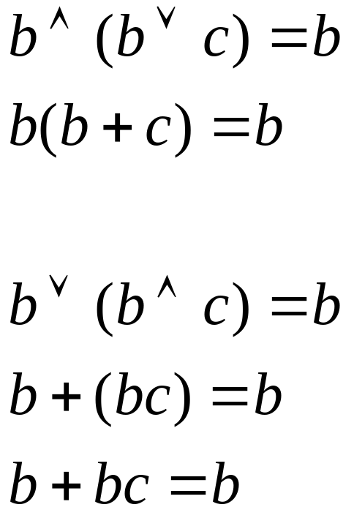
Absorption Laws

Slide 21




Dual Principle
If we swap
and
in a valid statement, the new statement is valid and is called the Dual Equality
eg

Slide 22


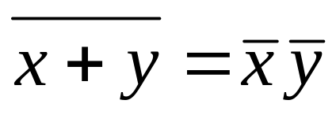
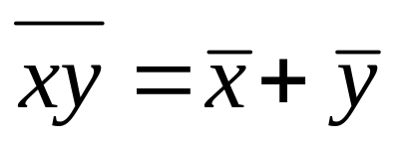
De Morgans Laws

Slide 23
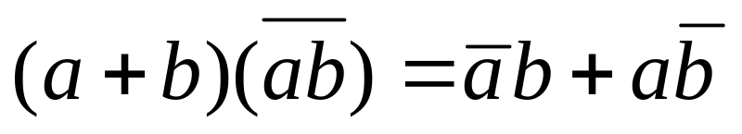
Worked Example 5
Show that
(a+b)(~a + ~b) = ~ab + a~b [de morgans]
~aa + a~b + ~ab + ~bb = ~ab + a~b [distributive]
0 + ~ab + a~b + 0 = ~ab + a~b [complement]
~ab + a~b = ~ab + a~b [identity]

Slide 24
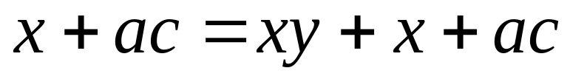
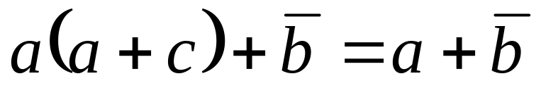
Worked Example 6
Show that
(a)
x + ac = (xy + x) + ac [associative]
x + ac = x + ac [absorption]
(b)
aa + ac + ~b = a + ~b [distributive]
a + ac + ~b = a + ~b [idempotent]
(a + ac) + ~b = a + ~b [associative]
a + ~b = a + ~b [absorption]

Slide 25
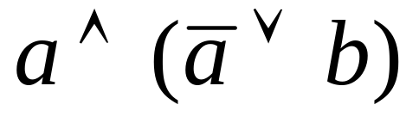
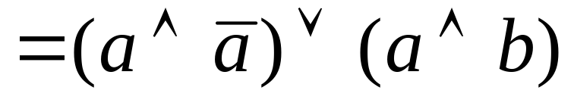
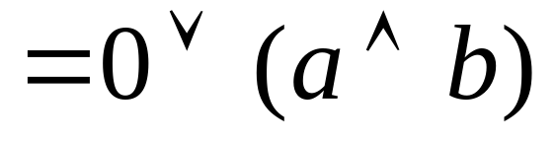
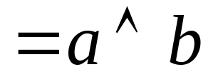
Example
Simplify

Slide 26
Summary
To simplify expressions or prove equivalency:
use truth tables
use Boolean algebra

Slide 27
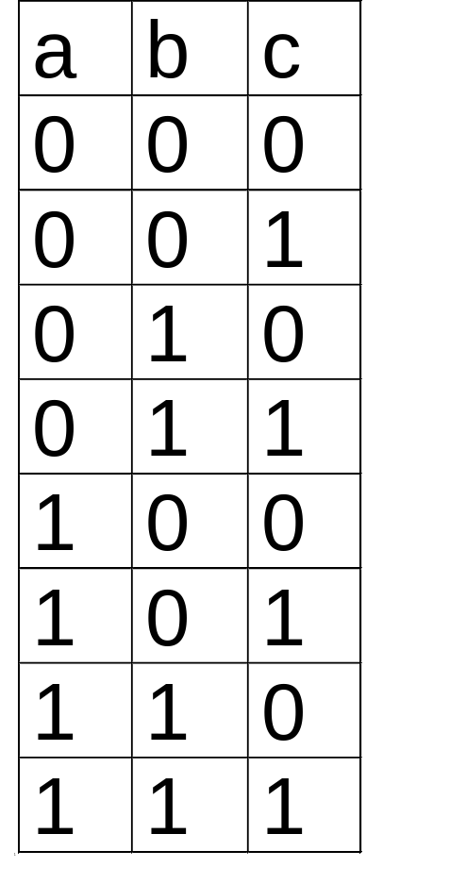
Boolean Truth Tables
Similar to logic truth tables
Except uses 0 for False and 1 for True
And starts with 000 (FFF) and ends with 111 (TTT)

Slide 28
Logic Gates
The building blocks of electronic circuits
Each gate receives inputs and delivers a single output

Slide 29
Three Basic Gates
AND OR NOT
These correspond to the 3 operations of a Boolean Algebra
x
xy
x
x+y
x
x
y
y

Slide 30
Convention for Logic Gates
Use + for “OR”
Omit the * for “AND”

Slide 31
Integrated Circuits
logic
gates
logic
circuits
integrated
circuits

Slide 32
Page 225 9-15(a)
x
y
z

Slide 33
Page 225 9-15(b)
x
y
z

Slide 34
Page 225 9-15(c)
x
y
z

Slide 35
Page 224
x
y
z

Slide 36
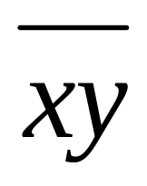
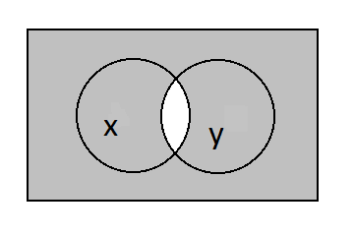
NAND Gate
x
xy
y

Slide 37
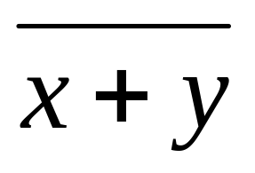
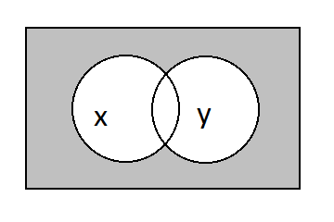
NOR Gate
x
x+y
y

Slide 38
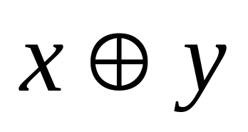
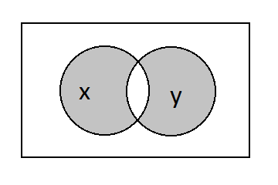
XOR Gate
x
x + y
y

Slide 39
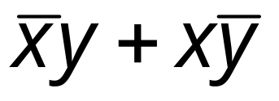
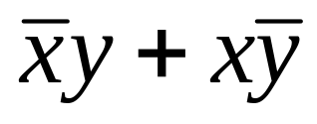
Worked Example
Sketch the logic circuit for
x
x
xy
y
xy
y
y

Slide 40
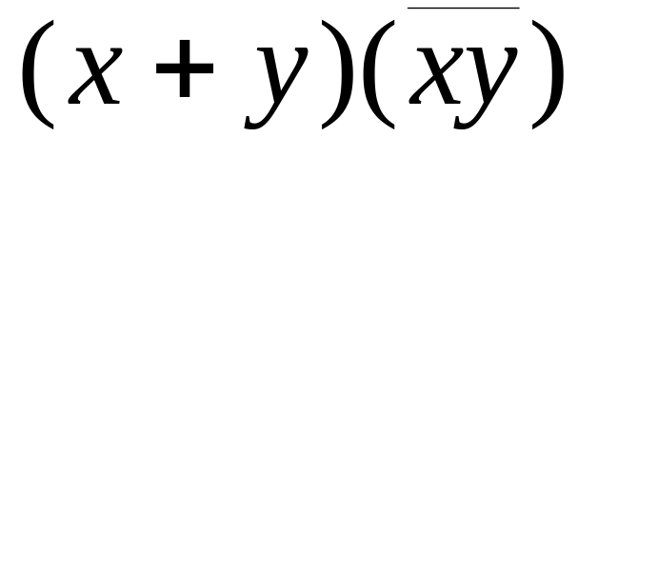
Sketch the logic circuit for
Compare this with the earlier circuit
These 2 could become a nand
x
xy
xy
y
x
x+y
(x+y)(xy)
y

Slide 41


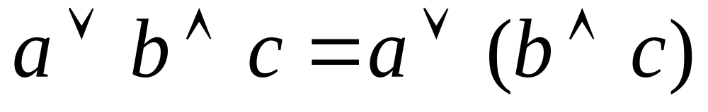
Order of Boolean Operations
takes priority over
Eg

